Slide 1


Post-WWII Paradigms on Race: Michel Foucault
    Prof. Rasmus Grønfeldt Winther
    www.rgwinther.com
    Humanities Division, University of California, Santa Cruz
    History of Consciousness 166: Race, Science, and Humanities

Slide 2
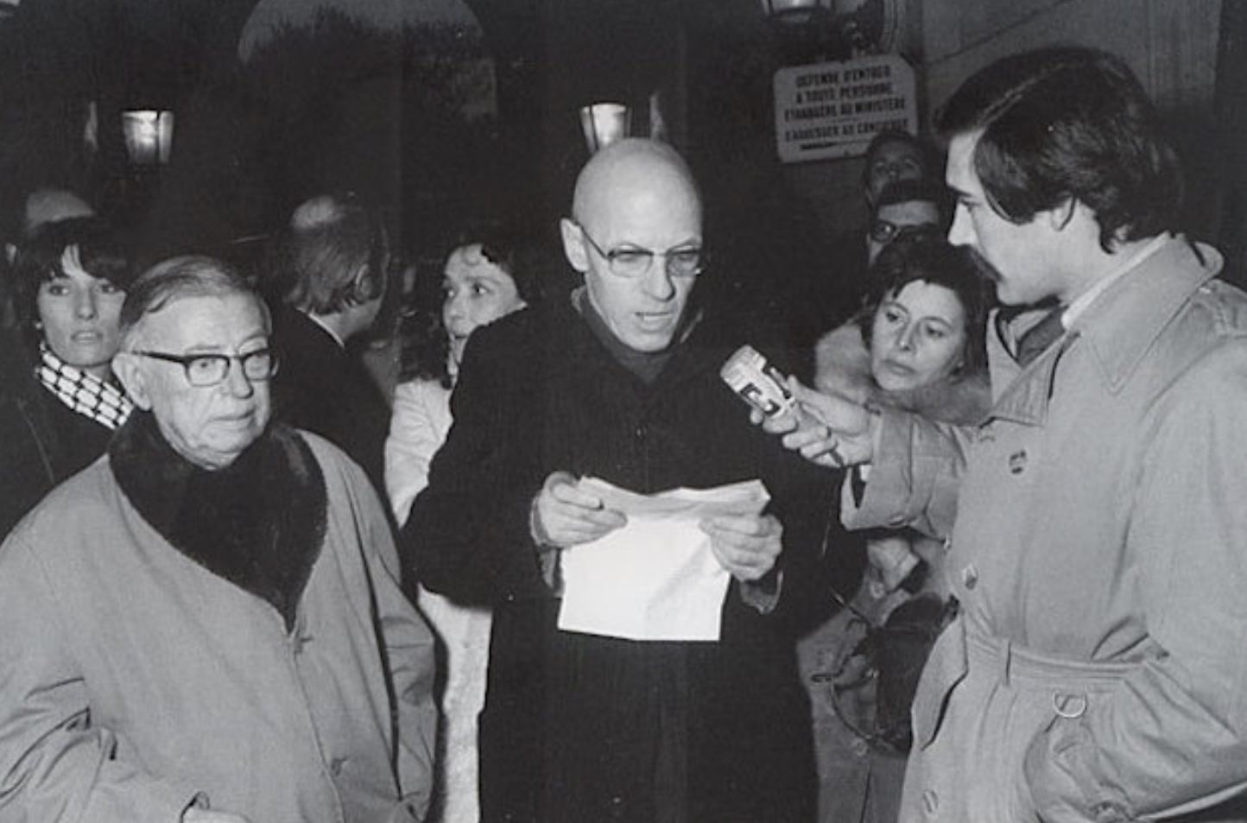
Michel Foucault
(and Jean-Paul Sartre)

Slide 3
Modern Historical Discourse:
Three Stages
:
“ROMES”-RACIST
Racial Purity,
State Sovereignty
REVOLUTIONARY:
Race Struggle, Counterhistory,
Jersusalem
Time
ROMAN:
“Jupiterian” History

Slide 4
Modern Historical Discourse:
Three Stages
:
“ROMES”-RACIST
Racial Purity,
State Sovereignty
REVOLUTIONARY:
Race Struggle, Counterhistory,
Jersusalem
Time
ROMAN:
“Jupiterian” History

Slide 5
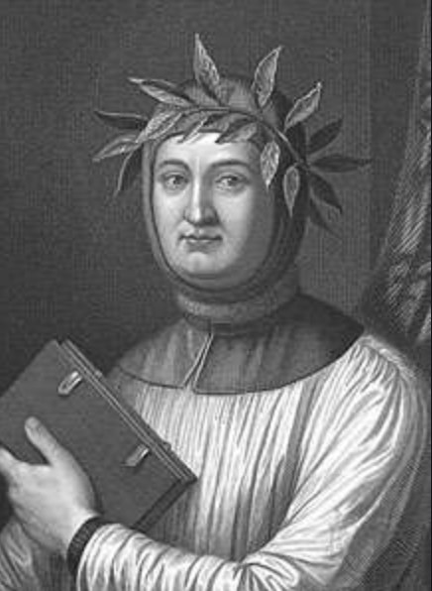
ROMAN HISTORY
“Is there nothing more to history than the praise of Rome?” Petrarch (74, 83)
Rome Invented Modern Europe

Slide 6
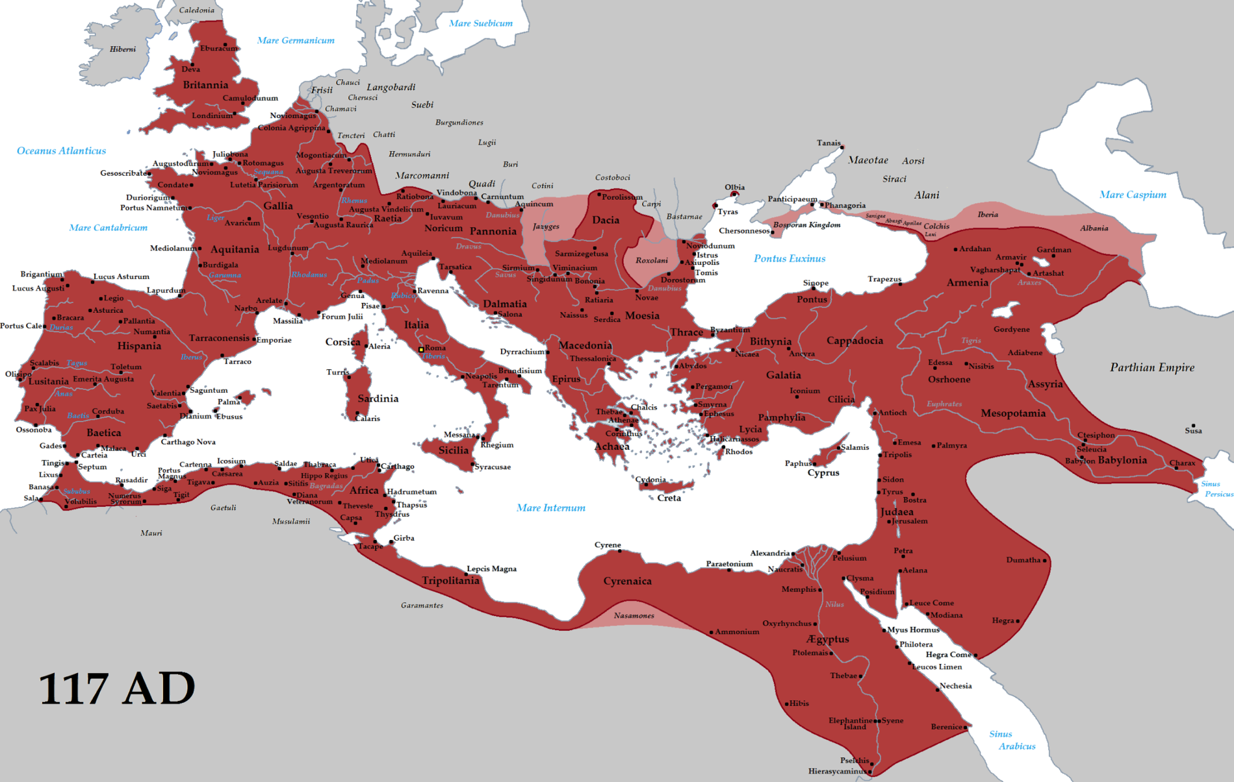
ROMAN EMPIRE:
MAXIMUM EXENT

Slide 7
EXERCISE
In which ways do you think Rome Invented Modern Europe?
How is this expressed in Modern USA?

Slide 8
PEUTINGER MAP (12th/13th centuries)

Slide 9
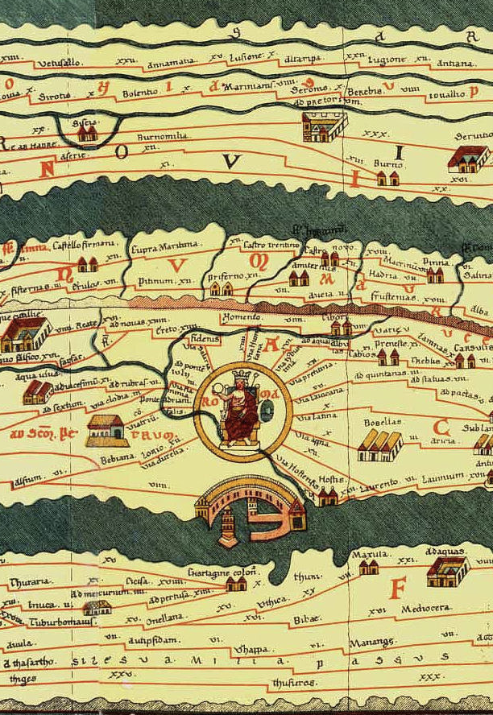
PEUTINGER MAP (12th/13th centuries)

Slide 10
OMPHALOS SYNDROME
The omphalos syndrome, where a people believe themselves divinely appointed to the center of the universe, shows its symptoms in the history of cartography as often as in ancient city planning. The oldest extant world map, inscribed on sun-dried brick from sixth-century B.C. Mesopotamia, illustrates a circular cosmos with Babylon in the middle. Both the early Christians and the Mohammedans placed their own holy shrines in the center of similarly circular charts of the cosmos. (Edgerton 1987, 26)

Slide 11
EXERCISE
In which ways is it “natural” for each of us to see ourselves as the center of the world?
In which ways is it “natural” for any given peoples to see themselves as the center of the world?
What are the risks and promises, ethically and politically speaking, with the omphalos syndrome.

Slide 12
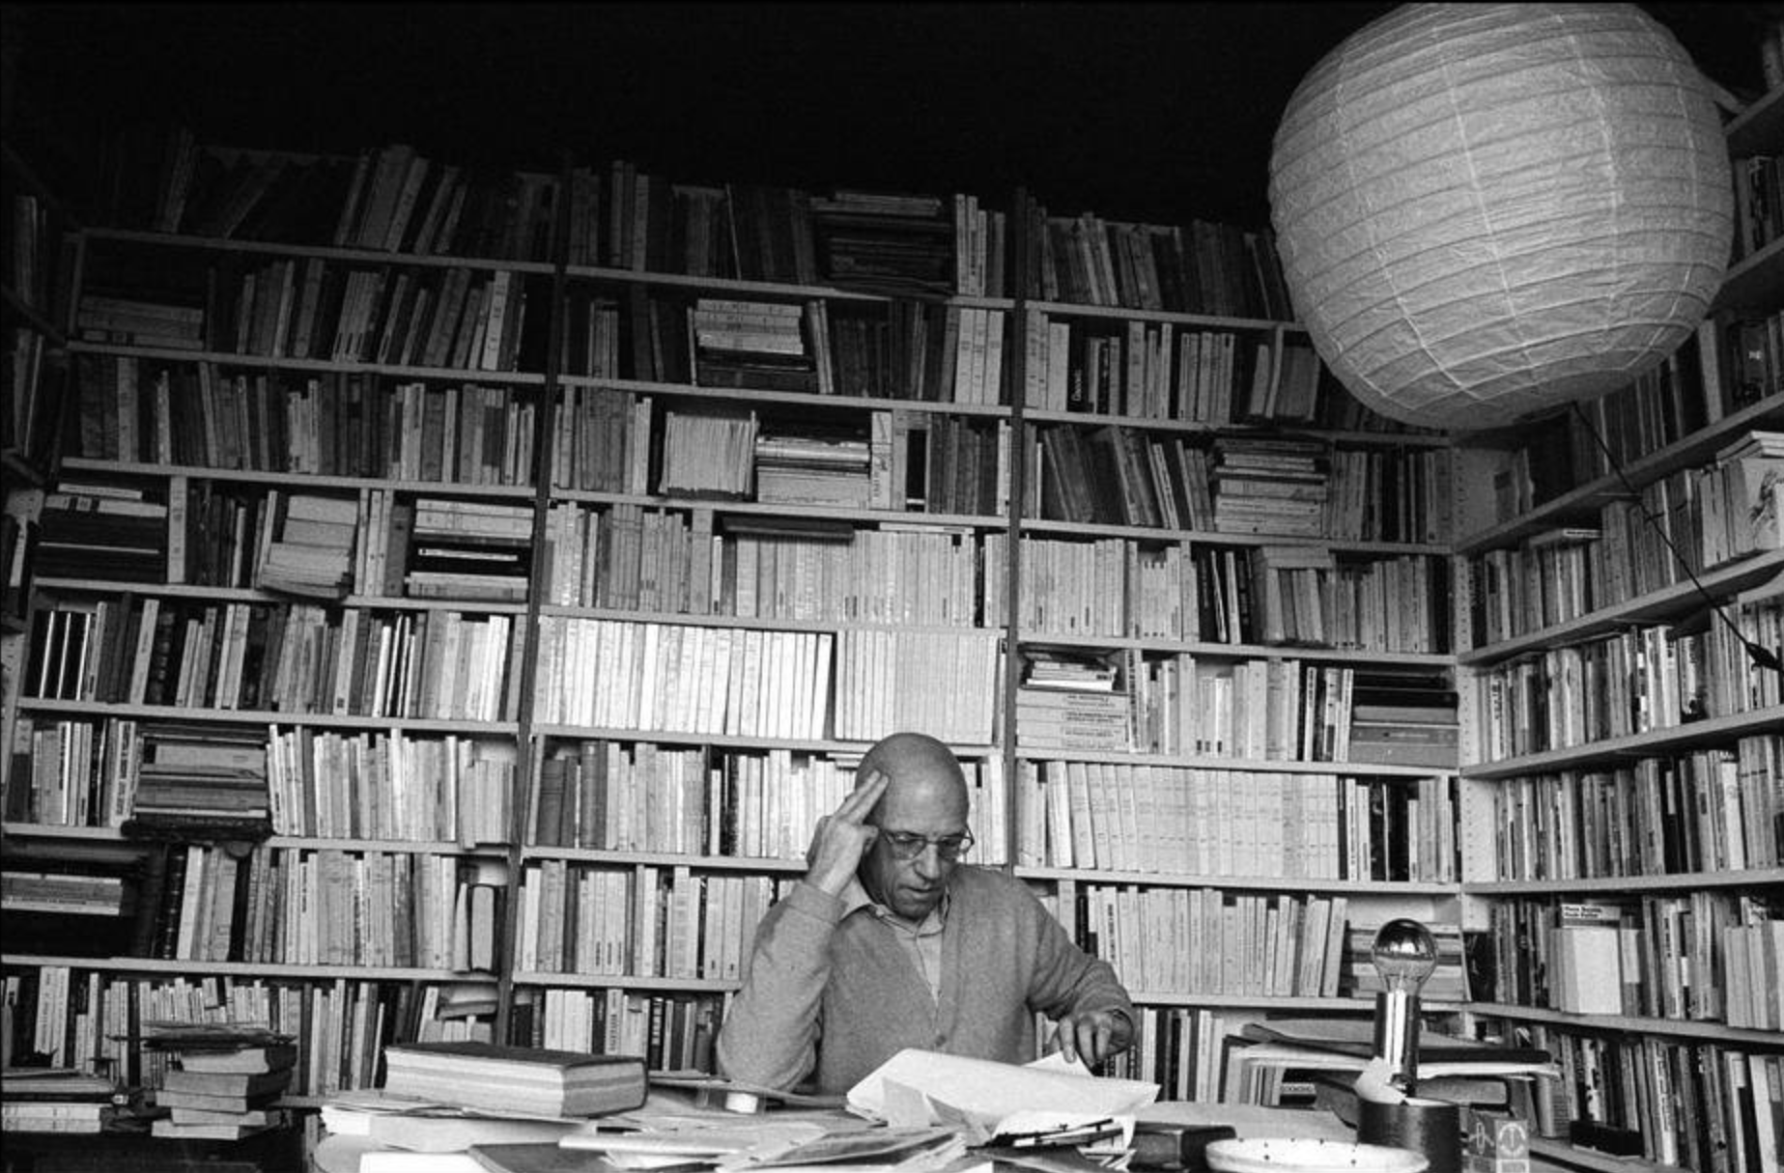
ROMAN HISTORY
Discourse of “the history of kings, the mighty sovereigns and their victories” (66)
Antiquity → Middle Ages
Three axes:
genealogical, memorialization, circulating examples (66-67)
Why?
JURIDICAL function: power uses obligations, oaths, commitments and the law to bind
MAGICAL function: power dazzles and… petrifies. (68)
A single individual with magico-juridical power (81)

Slide 13
A Brief History of Foucault (video)
https://www.youtube.com/watch?v=BBJTeNTZtGU

Slide 14
Modern Historical Discourse:
Three Stages
:
“ROMES”-RACIST
Racial Purity,
State Sovereignty
REVOLUTIONARY:
Race Struggle, Counterhistory,
Jersusalem
Time
ROMAN:
“Jupiterian” History

Slide 15
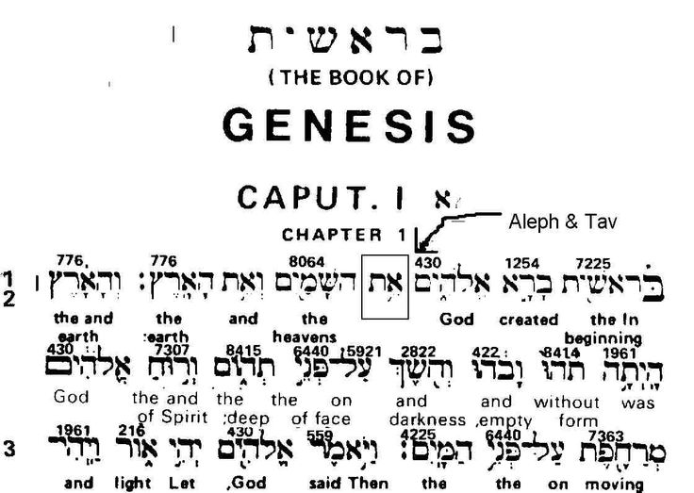
REVOLUTIONARY (COUNTER) HISTORY
…from the second half of the Middle Ages onward, the Bible was the great form for the articulation of religious, moral, and political protests against the power of kings and the despotism of the church. (71)
Bible as Revolutionary!

Slide 16
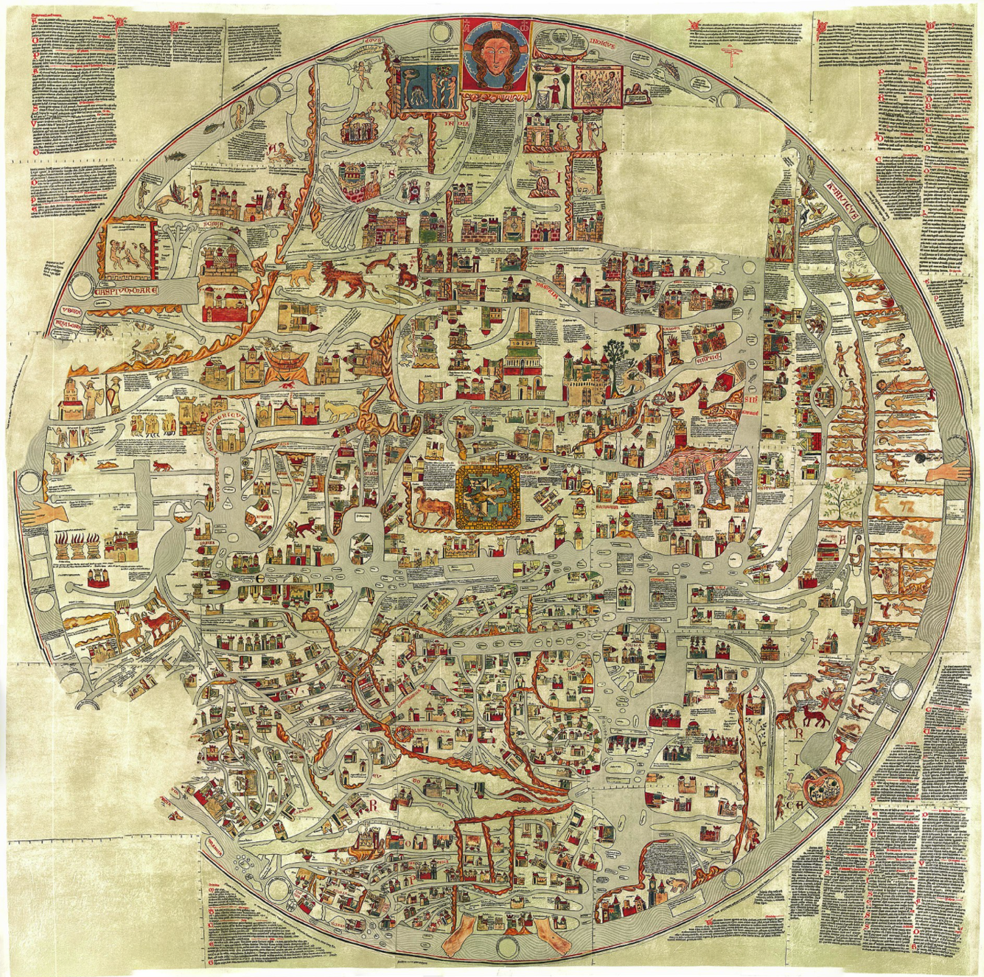
EBSTORF MAP (13th century)

Slide 17
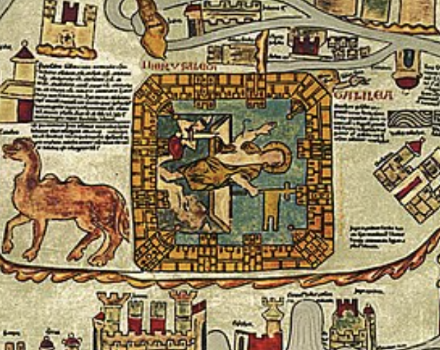
EBSTORF MAP (13th century)

Slide 18
REVOLUTIONARY HISTORY
“This new discourse of race struggle…is much closer to the mythico-religious discourse of the Jews than to the politico-legendary history of the Romans.” (71)
Late Middle Ages →17th/18th centuries
“…a protest, a critique, and an oppositional discourse.” (71)
“history…show[s] that laws deceive, that kings wear masks, that power creates illusions, and that historians tell lies.” (72)
Why?
A counterhistory, closely tied to revolutionary thought and action, for declaring rights (73)

Slide 19
Modern Historical Discourse:
Three Stages
:
“ROMES”-RACIST
Racial Purity,
State Sovereignty
REVOLUTIONARY:
Race Struggle, Counterhistory,
Jersusalem
Time
ROMAN:
“Jupiterian” History

Slide 20
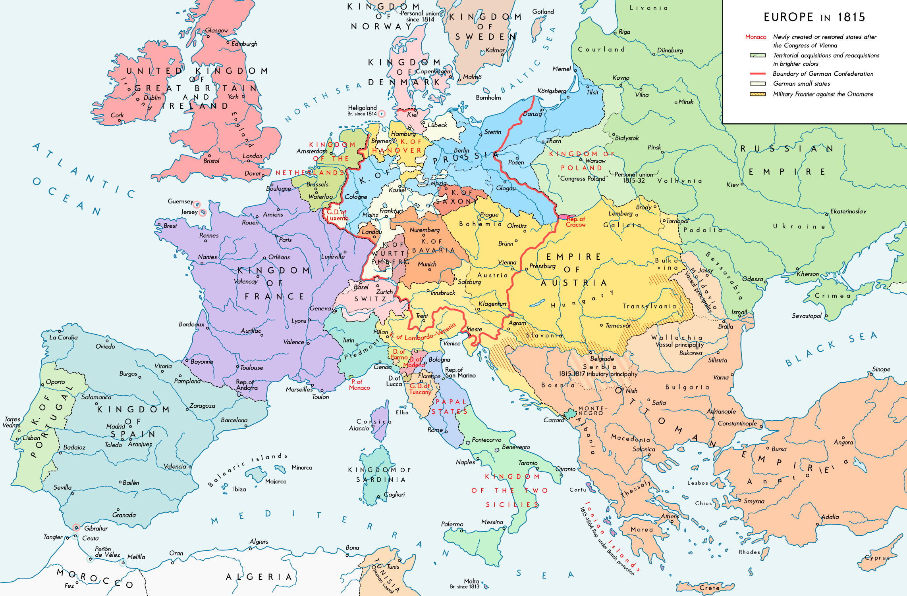
“ROMES”-RACIST HISTORY
The idea of racial purity, with all its monistic, Statist, and biological implications: that is what replaces the idea of race struggle. (81)
Many Romes; many world navels; colonialism ensues!

Slide 21
“ROMES”-RACIST HISTORY
“Racism is, quite literally, revolutionary discourse in an inverted form.” (81)
18/19th centuries → today
“Thanks to the shift from law to norm, from races in the plural to race in the singular, from the emancipatory project to a concern with purity, sovereignity was able to invest or take over the discourse of race struggle and reutilize it for its own strategy.” (81)
Why?
“The hoarse songs of the races that clashed in battles… became the administrative prose of a State that defends itself in the name of a social heritage that has to be kept pure.” (83)

Slide 22
EXERCISE:
Assumption Archaeology
“Thanks to the shift from law to norm, from races in the plural to race in the singular, from the emancipatory project to a concern with purity, sovereignity was able to invest or take over the discourse of race struggle and reutilize it for its own strategy.” (81)

Slide 23
Modern Historical Discourse:
Three Stages
:
“ROMES”-RACIST
Racial Purity,
State Sovereignty
REVOLUTIONARY:
Race Struggle, Counterhistory,
Jersusalem
Time
ROMAN:
“Jupiterian” History

Slide 24
TWO FINAL QUESTIONS
“Is there anything more to history than the call for revolution, and the fear of revolution?” (83)
“And what if Rome once more conquered the revolution?” (84)

